Slide 1
Analysis of Head Start Accessibility
Group : Dataminers
Member: Zizheng (Sean) Zhang
Yinming (Randall) Gao

Slide 2
Agenda
Background
Technologies In-use
Major Findings
Major Insights
One More Thing

Slide 3
Background
Established in 1965, Head Start promotes school readiness for children in low-income families by offering educational, nutritional, health, social, and other services. The program is rooted in urban, suburban, and rural communities throughout the nation.

Slide 4
Background (cont'd)
Service Mismatch: Only 30% of 3-to-5-year-olds and 9% of infants in poverty were served by Head Start.
COVID-19 Effect: A drop of 287,000 children in Head Start attendance in 2020-2021 compared to 2018-2019.
Funding Discrepancies: States with more child poverty receive less funding per child for Head Start.

Slide 5
Technologies In-use
Python: for data extraction, data analysis, statistical modeling, data pipeline automation, and web API development
HTML, CSS, Javascript: for web development
Tableau: for data visualization.
PowerPoint: for the presentation of insights.

Slide 6
Major Findings

Slide 7
Metrics
Center Coverage Rate (County level)
Children per Center
Enrollment Rate
Fund per Child

Slide 8
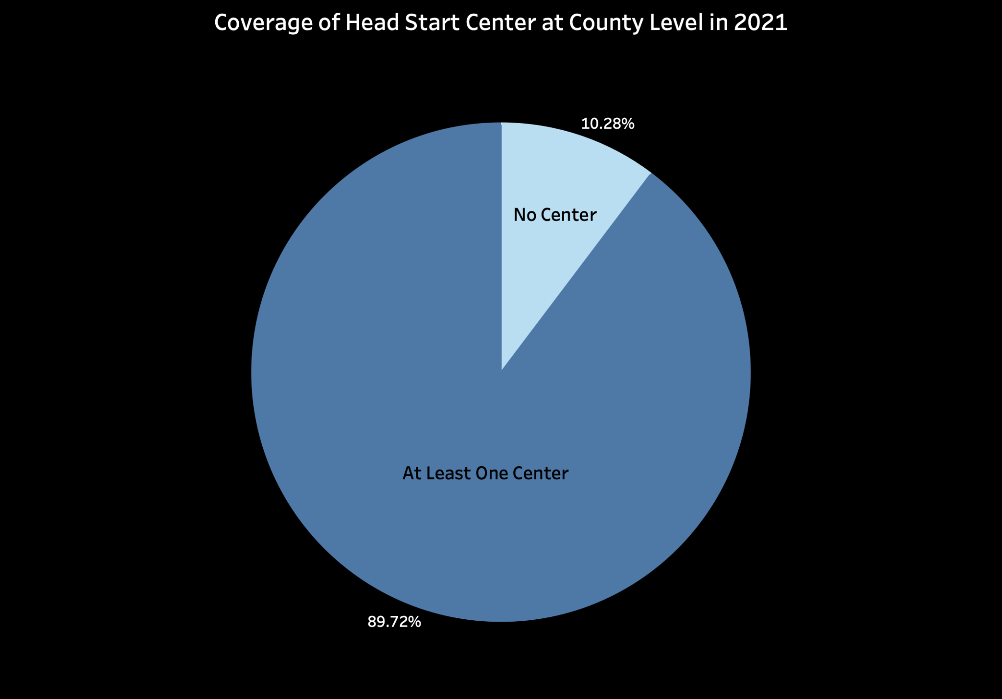
No Center: 315
At Least One Center: 2,748
Coverage Rate
= # of county with center/total # of county

Slide 9
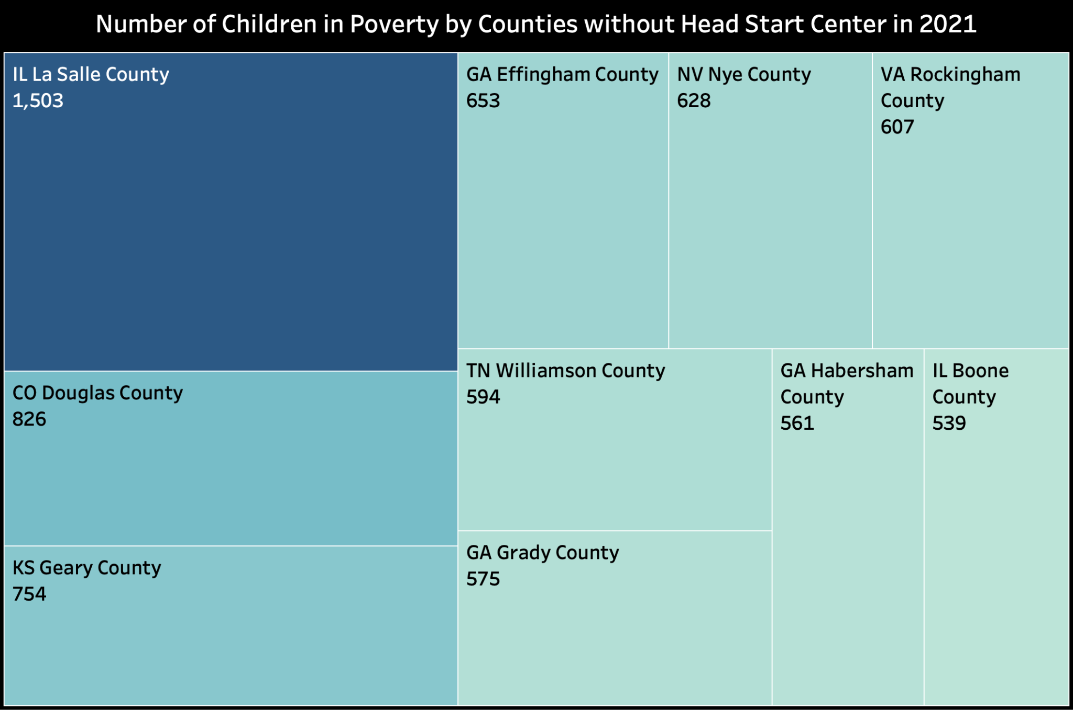
10 Counties without Head Start Center

Slide 10
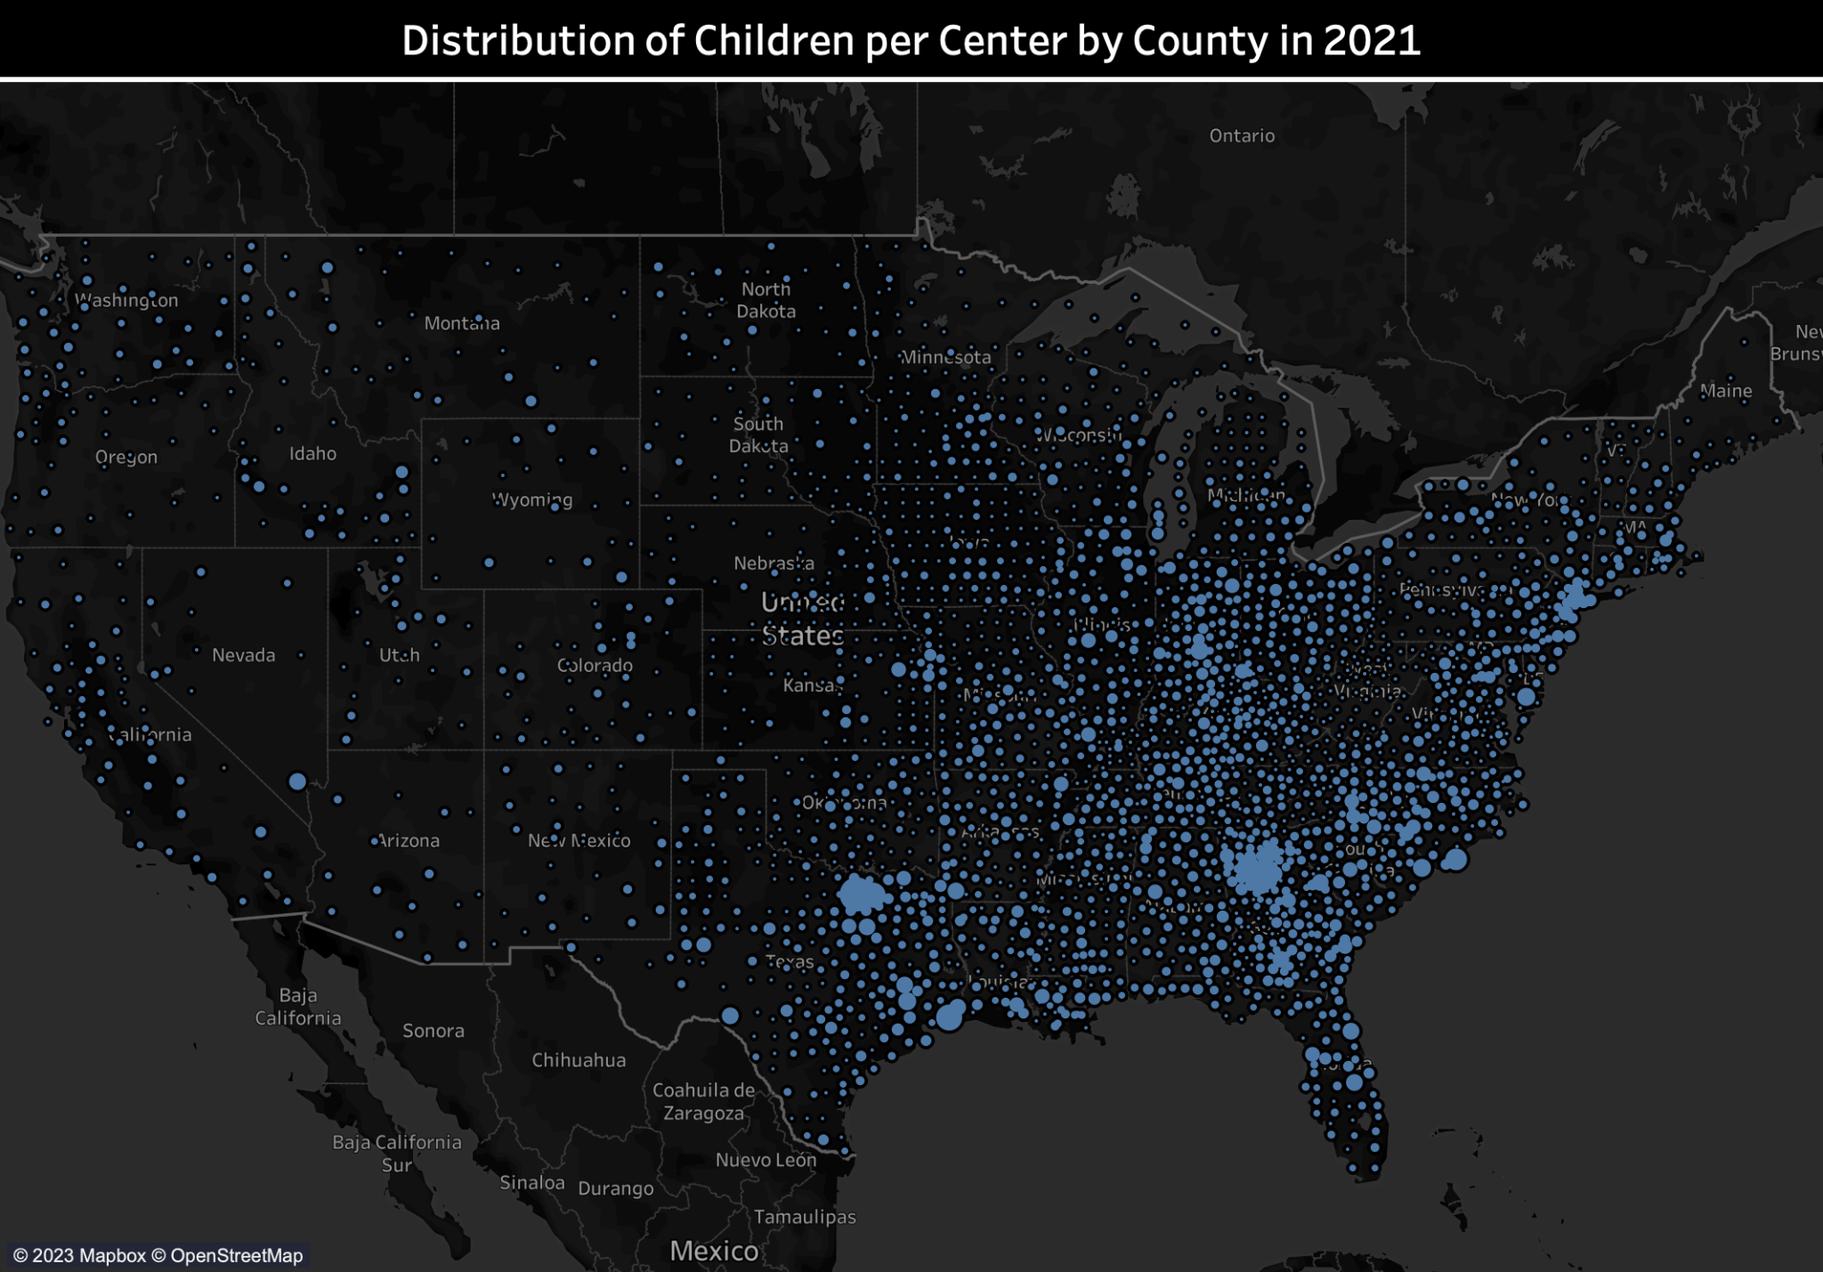
- Children/Center
- Texas & Georgia
- East & West

Slide 11
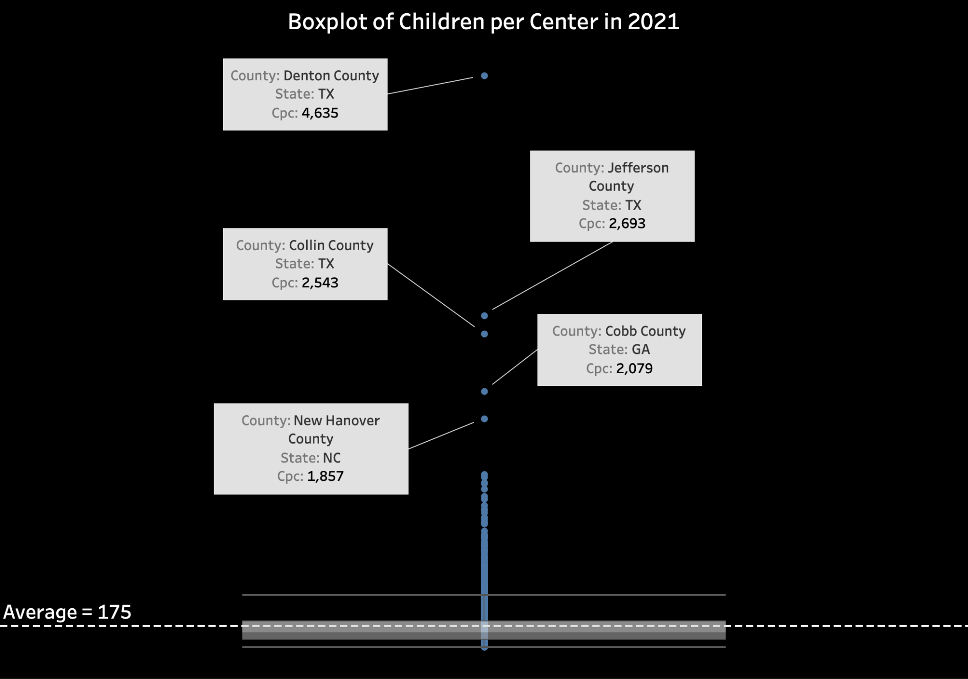
Cpc (Children per Center)
= # of children in poverty/# of center in one county

Slide 12
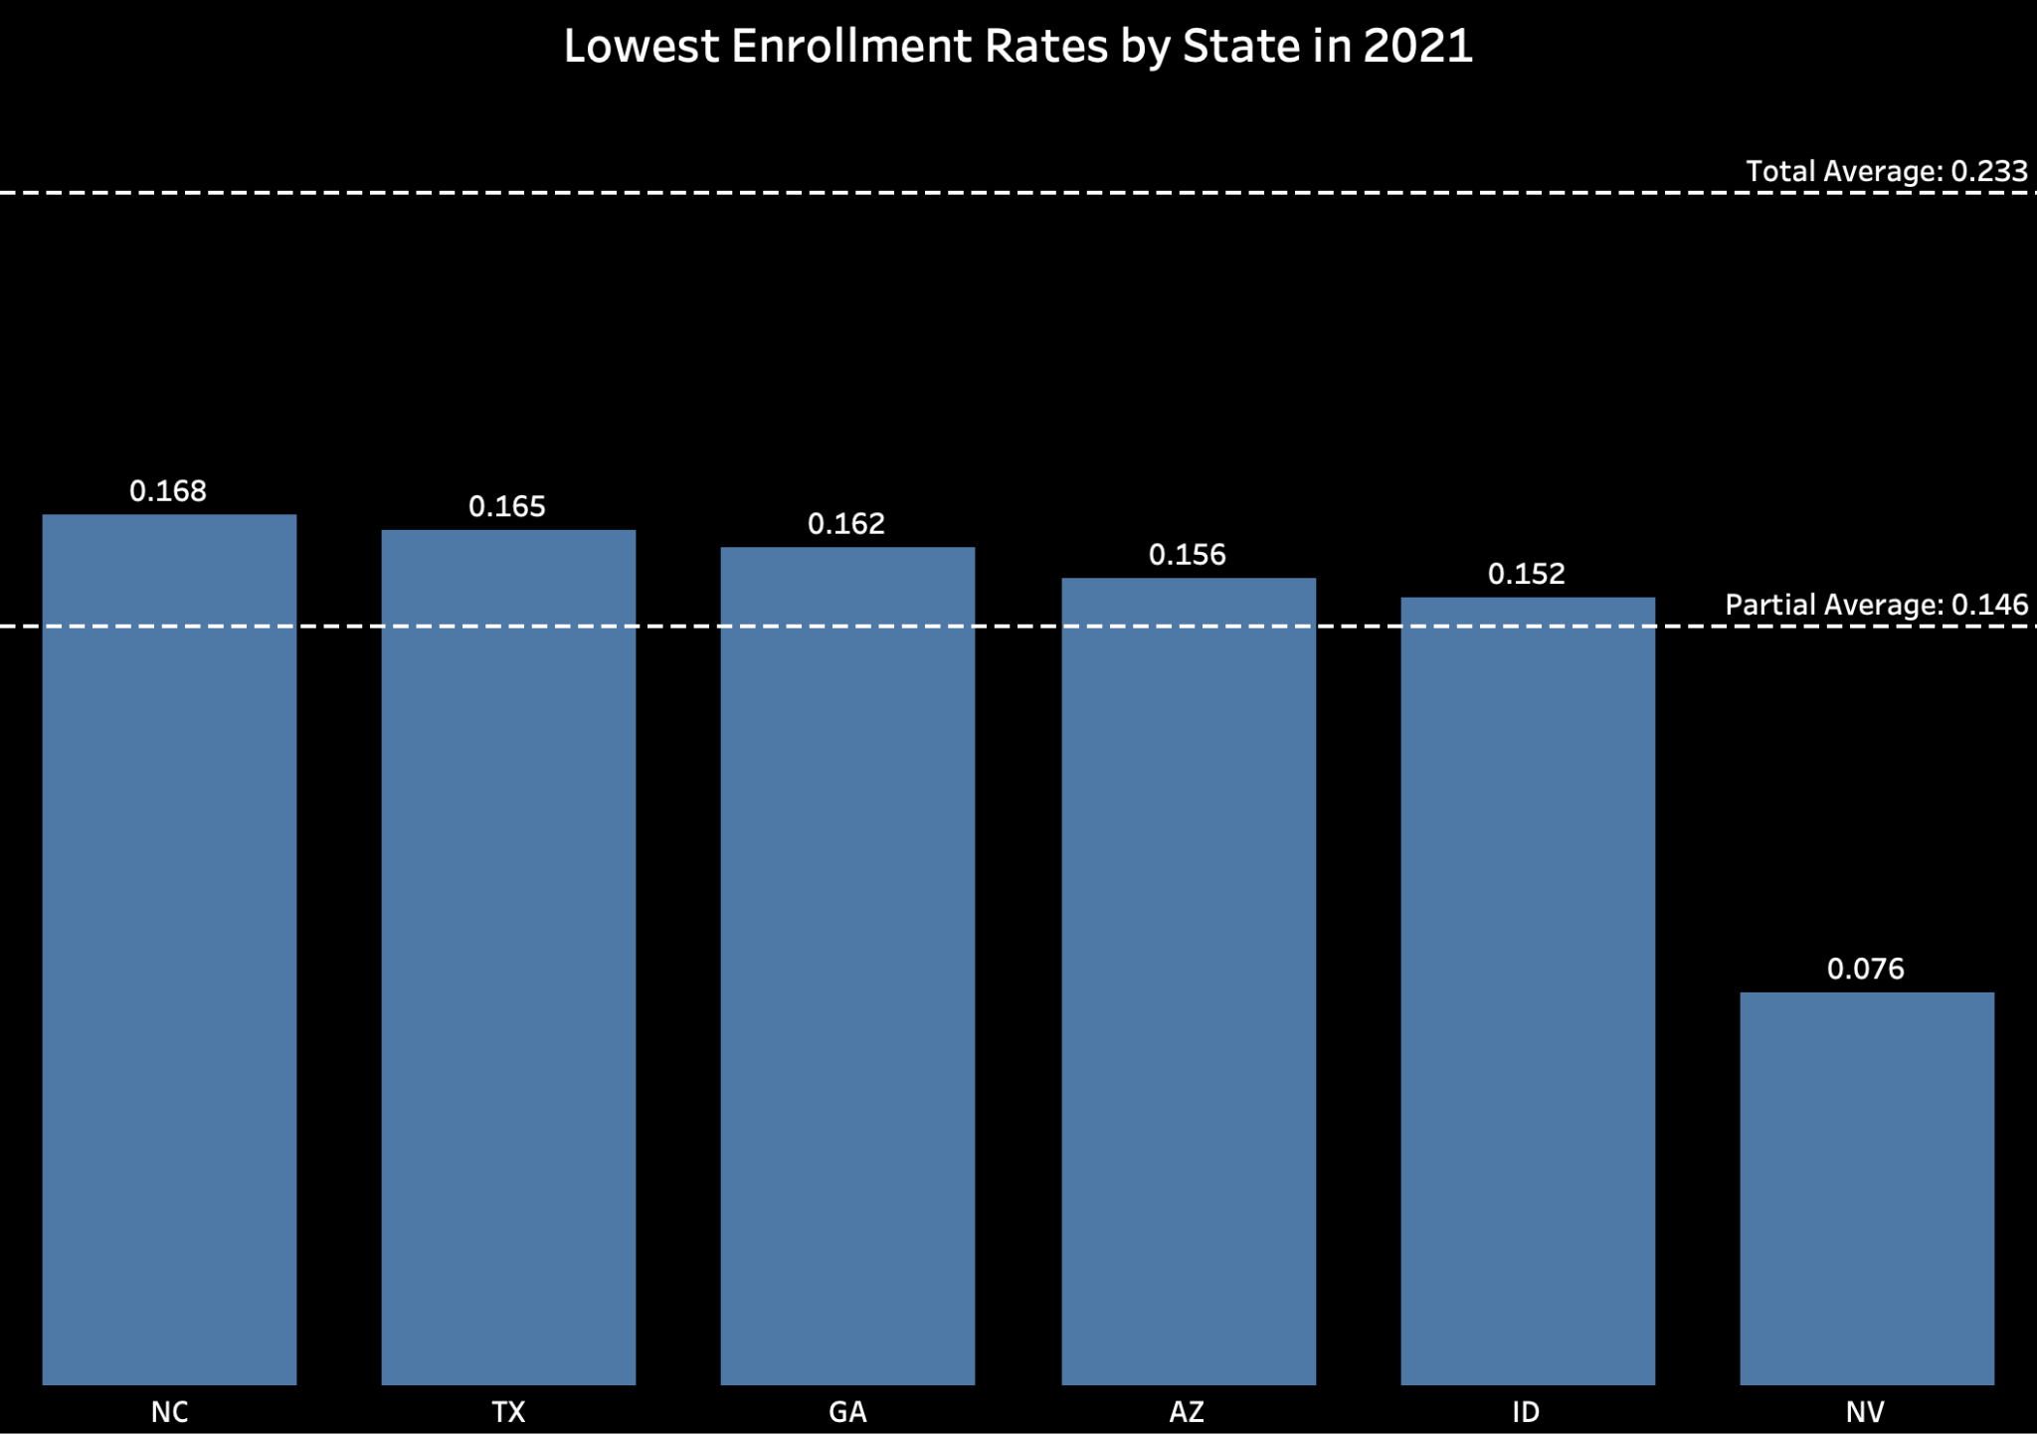
6 States with the Lowest Enrollment Rates
Enrollment Rate
= number of enrollments/ estimated number of children in poverty
Notes:
Definition of enrollment rate
Usage: to measure if the head start program is well utilized in an area
48 contiguous states were analyzed
Top six with lowest enrollment rate are listed here
Low enrollment rate implies three potential issues:
Too few public exposure so that families in poverty aren’t aware of head start
There are other local policies that have taken effect such that local families dont need head start
Head start program’s quality is poor at those areas.

Slide 13
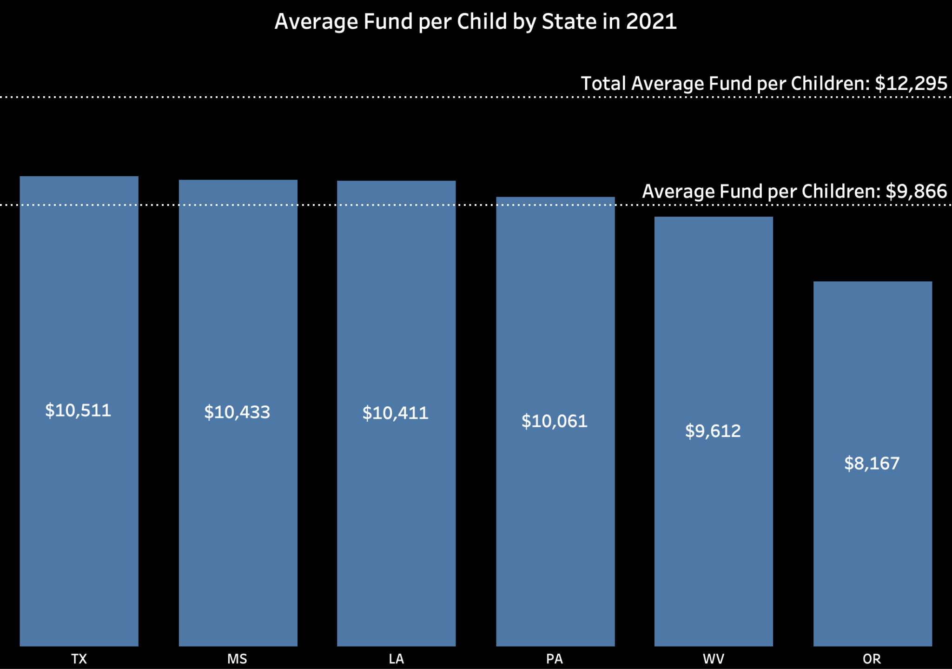
6 States with the Lowest Average Fund per Child
Fund/Enrolled Children
Notes:
Definition of fund per child: annual federal funding received divided by the number of enrollments.
Usage: measure and compare the fiscal support given to each region.

Slide 14
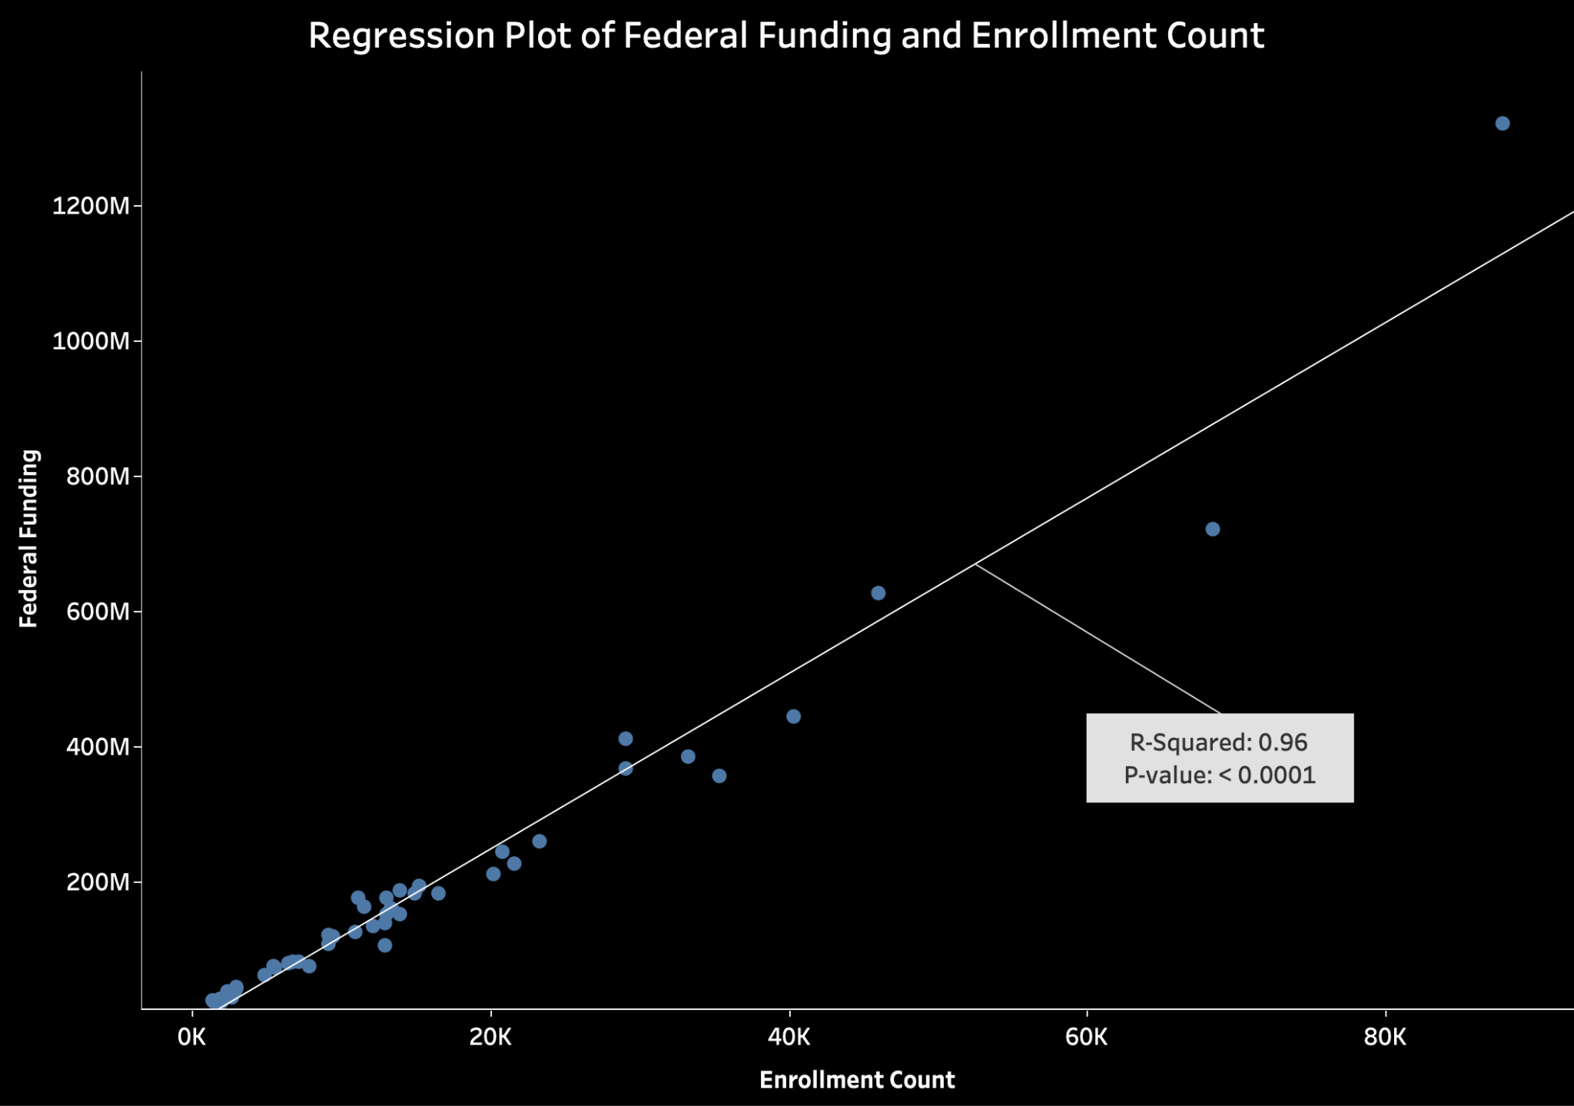

Slide 15
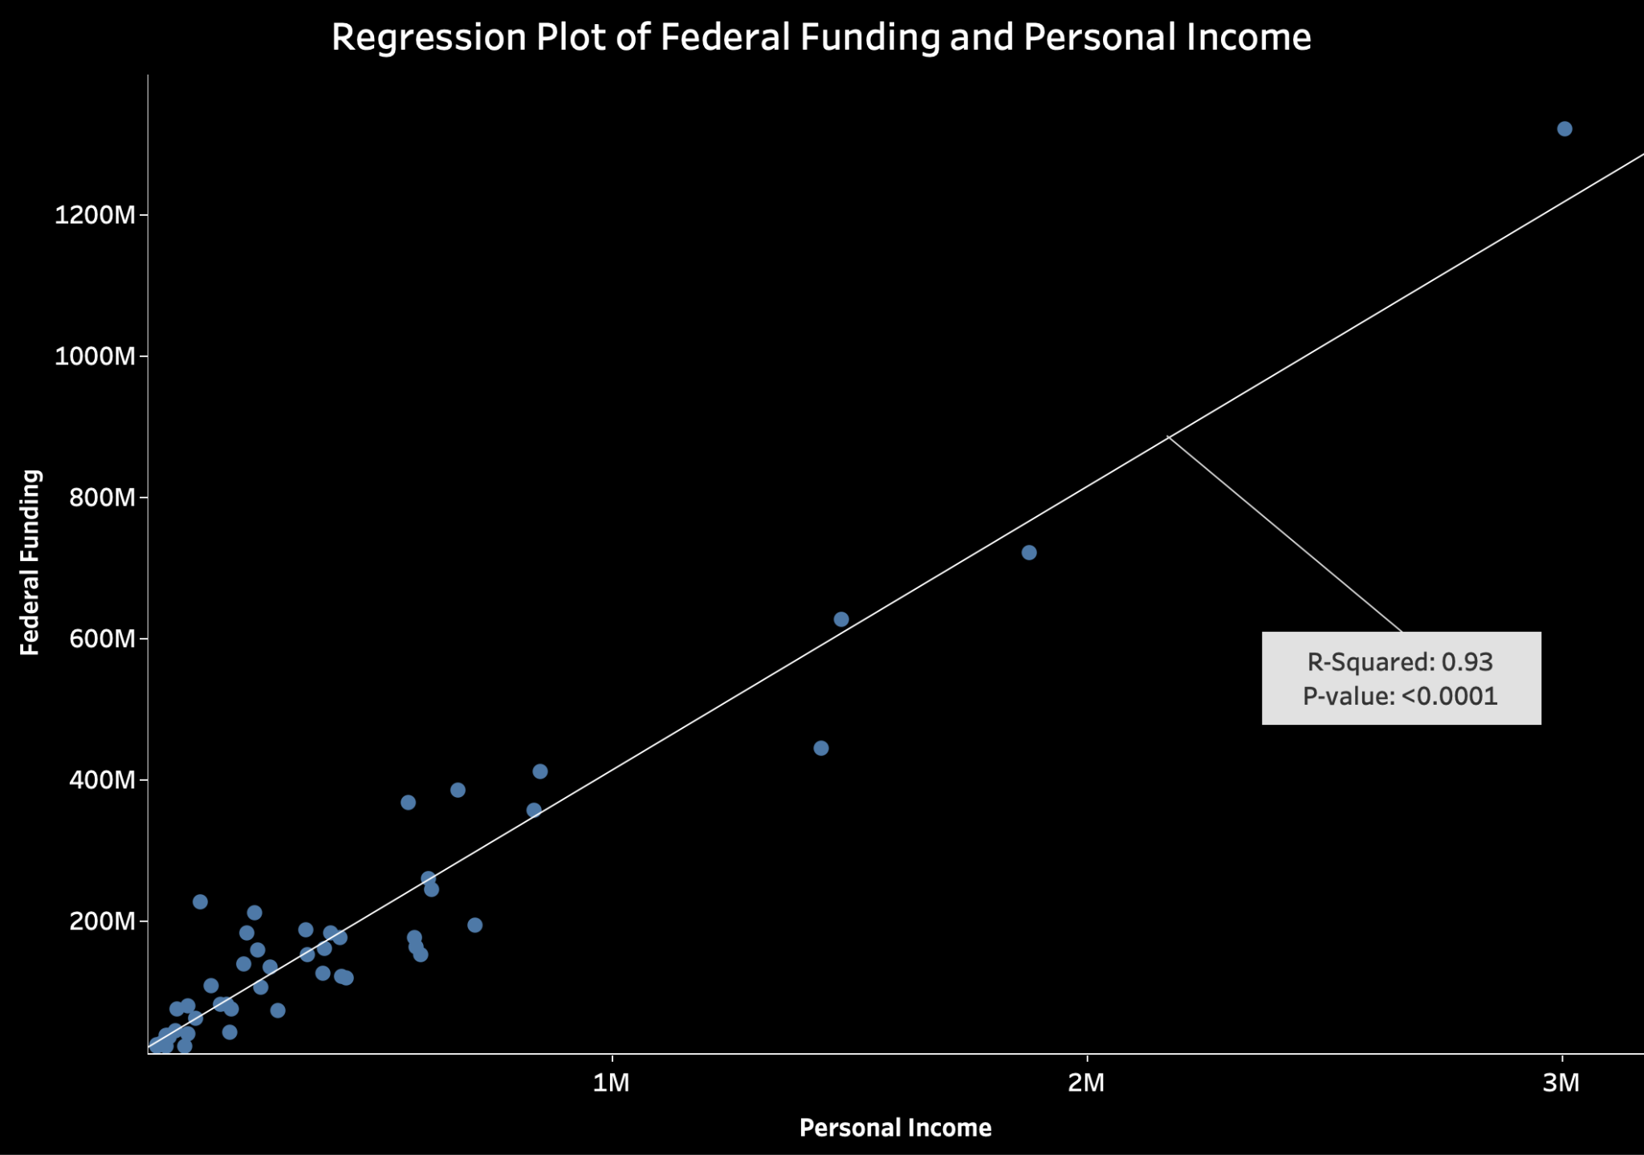

Slide 16
Major Insights

Slide 17
Major Insights - Policy Making
We found that there are clusters of counties in both Texas and Georgia where the metric children per center have abnormally high values, indicating potential scarcity of Head Start recourse in those areas. Policy makers may need to find more Head Start participants in those areas so as to facilitate the accessibility of Head Start.
Nevada, Idaho, Arizona, Georgia, and Texas are the states with the lowest estimated enrollment rate, meaning that the communities in these five states are very likely to be underserved. Policy makers may need to increase public exposure to Head Start, especially to low-income families, so that low-income families are aware of Head Start and begin enrolling in Head Start.
A linear regression model was built to better understand and evaluate the funding policy of Head Start. We achieved an adjusted R^2 score of 0.971, indicating very successful regression modeling. The model suggests a strong correlation between funding amount, enrollment amount, and regional personal income level, showing that the funding policy of Head Start is well tailored to the actual situation of each state.

Slide 18
Major Insights - Technology Innovation
In many cases, plain data are informative, but not ready to use. It is through an analytics pipeline where the raw data endures sequential processing and transformation that the underlying information and insights in the raw data become visible.
Automated analytics pipeline can remove the recurrent and repeated part of data analytics. For data of time series nature, such as annually updated data, assuming well defined metrics and robust external data sources, the acquisition, transformation, and loading of the data can be an automated process. The time series’ most recent values will be automatically updated by the pipeline itself.

Slide 19
One More Thing…

Slide 20
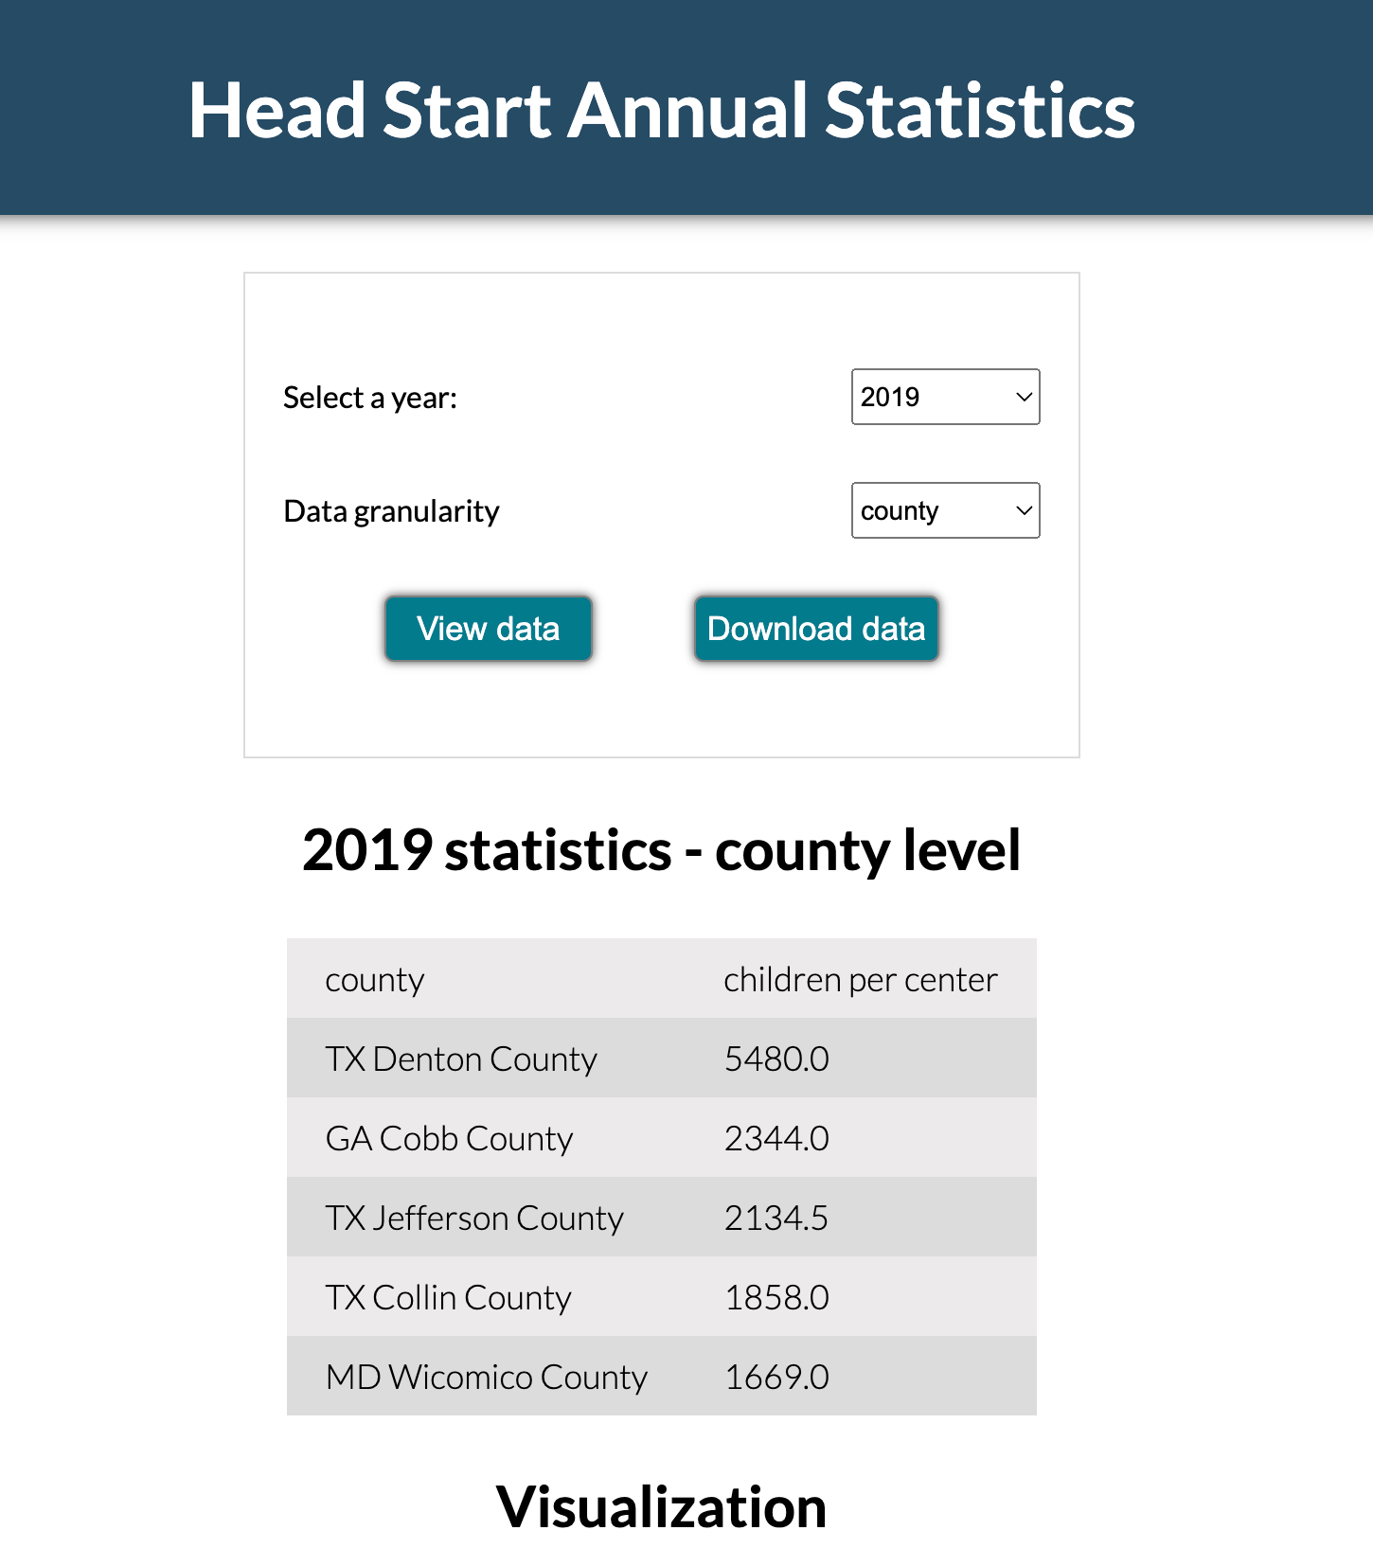
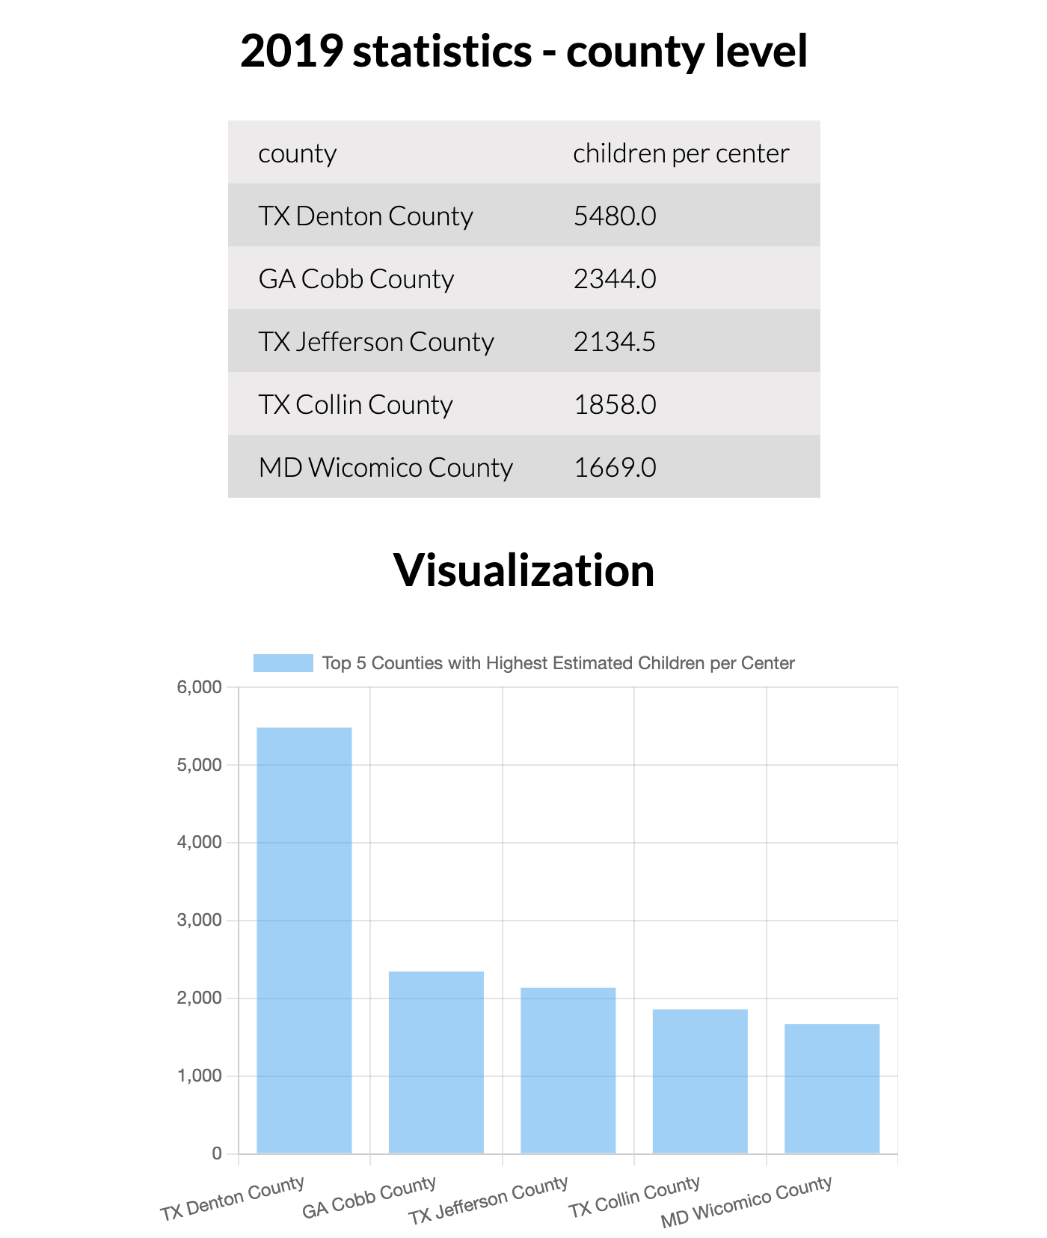
Automated Analytics Pipeline
54.237.226.144 (PC access for best experience)

Slide 21
Thank You!

